Slide 1


Your guide to safe, easy payments
Your welcome guide to AIB Merchant

Slide 2
Contents
Welcome | 3
Contact Us | 4
Self Service | 5
Terminal Support | 6
Who to Contact | 7
Contacts and Escalation | 9
Back Up Options | 10
eCommerce Support | 11
Transaction Types | 12
Insight | 13
Cardholder Data Security | 15
Fraud Prevention | 19
Chargebacks | 23
Merchant Cash Advance | 24
Fraud Prevention Checklist | 25
Handling a Chargeback | 26
Your First Week | 27

Slide 3
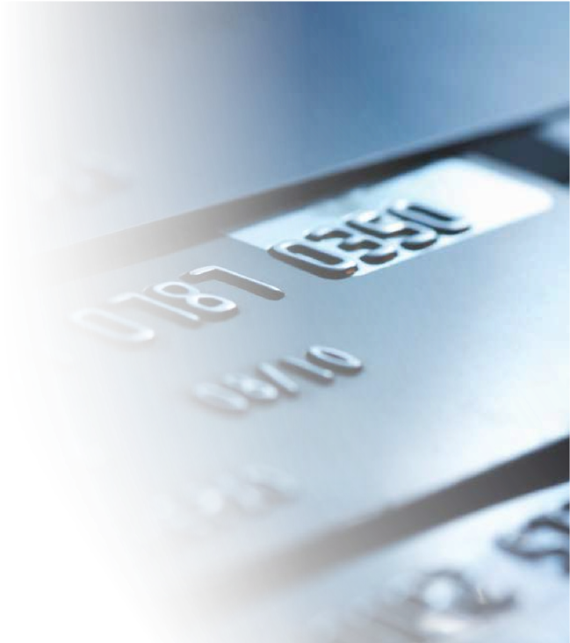
Welcome
You’re In Good Hands
Thank you for choosing us to process your card payments.
We process millions of payments every day with all the major card brands. When your customers pay by card, we’re in the background, making the payment safe and easy at the press of a button or the wave of a card.
We’ll keep you up to date with industry changes and developments across our product range, from contactless payments to Clover.
We’re Here to Help
We make it simple for you to process card payments, so you can focus on growing your business. We’re here seven days a week – 08:00 to 21:00 Monday to Friday, and 08:00 to 20:00 at weekends – because that’s how you work.

Slide 4
Contact Us
The numbers below are for customer service and Clover technical support only. PAX technical support is a different number, displayed on the front of your PAX device.
When you call, please have your Merchant number to hand – it is how we identify your business and your terminals.
NOTE: You can find your Merchant ID in several places:
Your welcome letter, and your monthly statement, where it appears as ‘Merchant Number’ at the top right of page 1.
On Clover devices, on the home screen beside Help (on a Flex, swipe to the far-left menu), or in the Clover Dashboard under the settings cog > Business Information. On a PAX terminal it is not shown on the device – use your statement or a recent receipt.
For terminal queries we will also ask for the terminal or serial number – on the sticker on the back of a PAX, or inside the paper compartment on a Clover. If you lease your terminal, your Lease ID can be used instead, and if you trade from more than one site we may also ask for the Store Number for that location.
ROI: 0818 021 062
NI: 0371 200 1437
GB: 0371 200 1436
Opening hours
Mon – Fri: 08:00 – 21:00 | Sat – Sun: 08:00 – 20:00

Slide 5
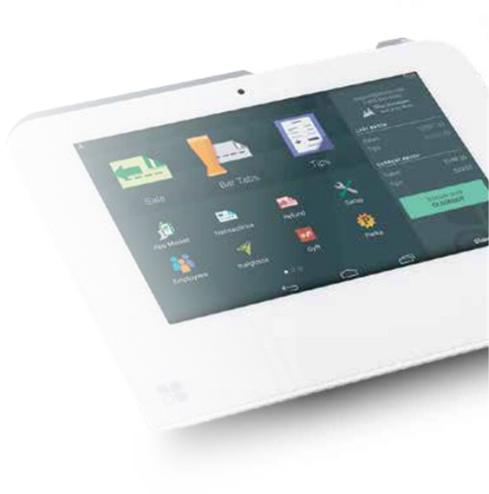
Self Service
Make account changes yourself, without picking up the phone.
The Self-service area of aibms.com lets you request the most common account changes online, at any hour. You will find it on the Self-service button in the top right of the site.
What you can request
Insight setup – get access to your transactions, statements and settlement information.
Change of bank account – update where your settlement funds are paid.
Change of address – update your registered or trading address.
Change of trading name – update the name that appears on your customers' statements.
What you need
Choose the request you want to make, then complete the online form with your business and contact details. Have your Merchant ID (MID) and your most recent statement to hand so you can confirm your details – your MID is at the top right of page 1 of your statement.
Good to know
Changes to bank details and trading name are subject to verification checks, so allow a few working days before they take effect. If your request does not fit any of the options above, use Get in touch on the same page or call Customer Services.

Slide 6
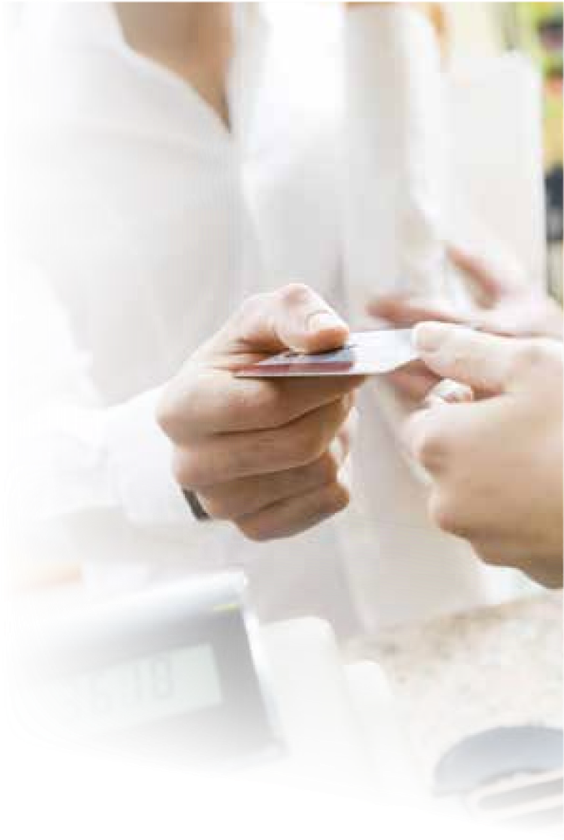
Terminal Support
Up and Running
All our terminals and Clover products are self-install devices. Just plug them in and within a few minutes you're up and running with payments.
But if you ever need to talk to us, here's how we can help you:
Terminal Helpline
Our support team are on hand seven days a week (08:00 – 21:00 Mon – Fri, 08:00 – 20:00 Sat – Sun) to talk you through your terminal installation. The helpline number is printed on the sticker on your terminal.
Engineer Support*
We can also arrange a terminal installation and support visit. To request one, or to check whether it is available for your terminal, call the terminal helpline number on your machine.
Before You Call
Have two numbers ready: your Merchant Number (also called your Merchant ID or MID) and your terminal serial number.
Your Merchant Number is on your welcome letter and at the top right of page 1 of your monthly statement. On Clover it is also on the home screen beside Help, or in the Clover Dashboard under the settings cog > Business Information.
Your serial number is on the sticker on the back of a PAX terminal, or inside the paper compartment on a Clover. If you lease your terminal we can use your Lease ID instead, and if you trade from more than one site we may also ask for the Store Number for that location.
* This service is only available to AIB Merchant Services direct customers and incurs a fee.

Slide 7
Contacts
Who to contact? | For?
Customer Services Mon – Fri (08:00 – 21:00) Sat – Sun (08:00 – 20:00) Email: Customerservice@aibms.com | General enquiries Funding queries Statement queries Change of Bank account details Change of address Adding additional outlets Insight Set Ups Insight Password resets
Clover Support – Dedicated support for Clover customers Mon – Fri (08:00 – 21:00) Sat – Sun (08:00 – 20:00) Email: Cloversupport@aibms.com | General enquiries Technical enquiries about your Clover Inventory queries Funding queries Statement queries Change of Bank account details Change of address Adding additional outlets
Terminal Support Please call the dedicated Terminal helpline number displayed on your machine. Mon – Fri (08:00 – 21:00) Sat – Sun (08:00 – 20:00) | Help with Terminal Install, Terminal usability Mac key resets Problems with terminals Replacement terminals Deliveries of terminals

Slide 8
Contacts
Who to contact? | For?
eCommerce Support Authipay Mon – Friday (09:00 – 17:00) Email: authipay@aibms.com Alternatively, if you use a different Payment Service Provider, you will need to contact them directly. | Technical enquiries about your payment gateway
Chargebacks Mon – Fri (09:00 – 17:00) ROI: 01 247 6483 GB: 01268 298981 Email: chargebacks@aibms.com | General chargeback enquiries Chargeback defence
FDGL (First Data Global Leasing) Mon – Fri (09:00 – 17:00) Email: firstdatagloballeasing@firstdata.com | Leasing enquiries Lease changes VAT schedules
Complaints Mon – Fri (09:00 – 17:00) Email: aibcomplaints@aibms.com | Expressions of dissatisfaction Raising a complaint

Slide 9
Contacts and Escalation
Who to contact? | Contact details | Merchant Procedure Guide
Customer Services | ROI: 0818 021 062 NI: 0371 200 1437 GB: 0371 200 1436 customerservice@aibms.com Mon – Fri 08:00 – 21:00, Sat – Sun 08:00 – 20:00 | Section 2.2.4
Self-service portal | aibms.com – Self-service | Section 2.2.1
Clover Support | cloversupport@aibms.com Mon – Fri 08:00 – 21:00, Sat – Sun 08:00 – 20:00 | Section 2.2.4
Terminal Support | Helpline number on the sticker on your terminal Mon – Fri 08:00 – 21:00, Sat – Sun 08:00 – 20:00 | Sections 2.2.4 and 7.2
Manual authorisation (voucher fallback) | ROI: 01 247 6544 UK: 0345 604 1625 | Section 7.2.1
eCommerce / Authipay | ROI: 0818 021 062 NI: 0371 200 1437 GB: 0371 200 1436 authipay@aibms.com Mon – Fri 09:00 – 17:00 | Section 2.2.4
Chargebacks | ROI: 01 247 6483 GB: 01268 298981 chargebacks@aibms.com Mon – Fri 09:00 – 17:00 | Section 2.2.4 and Section 5
Cardholder Data Security (PCI) | ROI: 1800 81 66 05 NI: 0330 808 1653 GB: 0330 808 1652 datasecurity@aibms.com Mon – Fri 09:00 – 17:00 | Section 3.3
FDGL (First Data Global Leasing) | firstdatagloballeasing@firstdata.com Mon – Fri 09:00 – 17:00 | Sections 6.1 and 6.3
Complaints, and escalation | aibcomplaints@aibms.com Mon – Fri 09:00 – 17:00 If unresolved: FSPO (ROI) 01 567 7000, info@fspo.ie Financial Ombudsman (UK) 0800 023 4567 | Section 6.2
Section references are to the AIB Merchant Services Merchant Procedure Guide. Reviewed internally each year.

Slide 10
Back Up Options
If you experience any problems with your terminal, please contact your dedicated terminal helpline who will try to solve the problem over the phone. If we can’t, we’ll send you a free replacement part or machine.
While you wait for your replacement part or machine you can use our manual vouchers or Virtual Terminal back up options. We can tell you about these if you call us.
Please Note: The Virtual Terminal option is not suitable to all customers.

Slide 11

eCommerce Support
If you sell goods or services over the internet, you will need a website and an associated payment gateway. Please contact your Payment Service Provider to ensure your online payment facility has been set up correctly.
3D Secure
When processing payments online we strongly recommend 3D Secure – now branded Visa Secure and Mastercard Identity Check – to minimise the risk of online fraud. Under Strong Customer Authentication rules, most online payments also have to be authenticated this way.
NOTE: Please talk to your payment service provider about implementing 3D Secure on your website.

Slide 12
Transaction Types
Transaction Type | Definition | Cardholder Verification Method | Standard
Sale | Sales of goods or services. | Chip & PIN Magnetic Stripe & Signature Contactless* | Yes
Refund | Repayment of a Sale. | Chip & PIN Magnetic Stripe & Signature Contactless* | Yes
Voice Referral | Sometimes we will ask you to call our Authorisation Centre on the number on the terminal. This happens when the cardholder’s bank needs more information. | N/A | Yes
Mail Order/ Telephone Order (MOTO) ** | Sales of goods or services via mail order or telephone order | Expiry date Address verification (UK only) CV2/ CVV | No
e Commerce | Sale of goods or services via the internet (websites or online stores) | Expiry date Address verification (UK only) CV2/ CVV 3D Secure (Visa Secure or Mastercard Identity Check) | No
Purchase With Cash Back (PWCB)** | This is more commonly known as Cashback. This is where the cardholder asks for cash as well as the sale when paying with their debit card. | Chip & PIN Magnetic Stripe & Signature | No
* Contactless (including Apple Pay and Google Pay) transactions are limited to a maximum transaction value set by the Card Issuer.
** If you don't already have MOTO or PWCB enabled on your terminal please call our terminal support team who will be happy to assist.
Manual keying is only permitted for Card Not Present transactions where this has been enabled on your account. Never manually key a transaction when the cardholder is present.

Slide 13
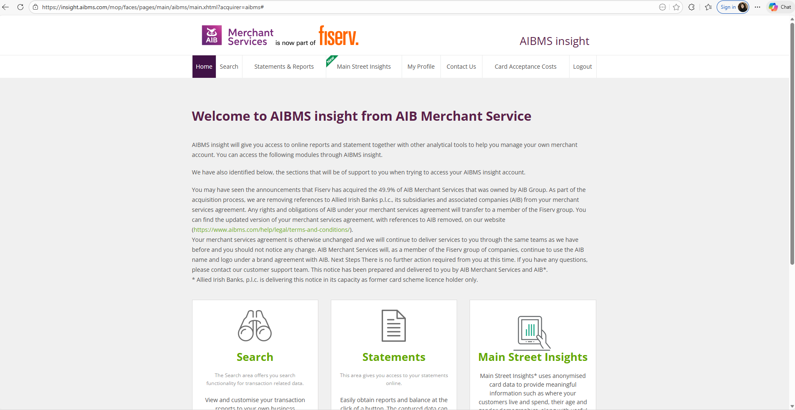
Insight
Insight is an online system which gives you all the information you need to manage your AIB Merchant Services account.
With It, You Can:
View and download statements.
Download documents in different formats, (html, xls, pdf or zip), so you can choose the best way to view and analyse your transactions.
Get your real-time balances.
You are enrolled in Insight automatically when your account is set up, and your login details are emailed to you. If they do not arrive, email aib.helpdesk@aibms.com or call Customer Services and we will resend them.
Main Street Insights (Republic of Ireland only): if your business is based in the Republic of Ireland, your Insight portal also includes Main Street Insights, giving you tailored analytics and location-specific data about your customer base and business performance.

Slide 14
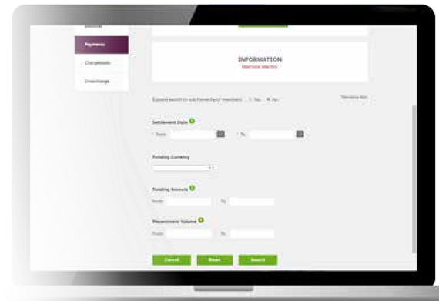
Insight
Payments
To help ease your reconciliation overheads, AIB Merchant Services Insight provides a daily overview of payments made into your nominated bank account.
By choosing the Payments option you can view your daily lodgements based on:
Merchant ID
Brand (i.e. card type Visa, MasterCard)
Service type (chargeback / sales/ refunds)
Transaction and billing currency
Gross amount
Net amount
Merchant Service Charge (MSC)
If you cannot access Insight, or you need your log-in details resent, contact our Customer Services team.

Slide 15
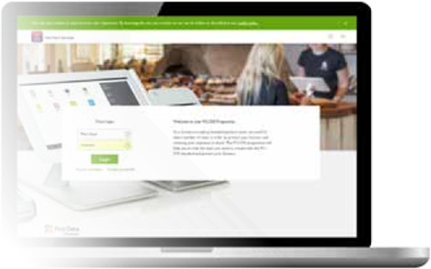
Cardholder Data Security (PCI)
Keeping Cardholder information secure is one of the things that builds trust with customers, so there are standards we all must meet to make sure we earn their trust.
These standards relate to the secure storage, processing, transmitting and management of cardholder information. As a merchant you must confirm your compliance with these standards each year. You can do this easily through the AIB Merchant Services Data Security portal. Your portal log-in details are sent to you when your account is set up; if you do not have them, contact our Data Security team at datasecurity@aibms.com.
Worldwide Standards
The Payment Card Industry Data Security Standards (PCI DSS) are worldwide requirements for consumer cardholder data protection. They were jointly created by VISA, MasterCard, American Express, Discover Card Financial Services and JCB, so that there is one unified set of data security standards.
These requirements ensure that consumers’ card details are protected from fraud. You can find out more here: https://www.pcisecuritystandards.org/
*What you must do, and by when
Complete your data security validation in the AIB Merchant Services portal within 30 days of your first transaction, and again every 12 months.
If you are unsure which questionnaire applies to you, call Customer Services before you start.

Slide 16

Cardholder Data Security (PCI)
  What Happens When an Organisation Doesn't Follow the Standards?
If cardholder data is not held securely, the consequences fall on your business. A data breach can mean card scheme fines, the cost of a forensic investigation, liability for fraudulent transactions, and the time and reputational damage of telling your customers what has happened.
Businesses that have not completed a valid annual data security validation may also be charged a non-compliance fee, and in serious cases card scheme rules allow card processing to be restricted.
Staying compliant is straightforward. Log on to our Data Security Portal at www.aibmsdatasecurity.com using the log-in details sent to you when your account was set up.
(If you don't have your username and password, contact our Data Security team and they will give you the details you need).
Once logged in, you will be asked some questions about how you store card data.
To help speed up the process, please have the following to hand:
Merchant Number
Make and Model of your terminal
IP address of the business location, if you use an internet-connected terminal

Slide 17
Cardholder Data Security (PCI)
Benefits of Card Data Security
Meeting the standards is not just a box to tick – it protects your business every day.
Protects your customers. Card details are handled and stored in a way that makes them far harder to steal.
Protects your money. It helps you avoid scheme fines, non-compliance fees, investigation costs and liability for fraudulent transactions.
Protects your reputation. Customers keep trusting you with their card details, and you avoid having to tell them about a breach.
Keeps you trading. Compliant businesses are not exposed to the processing restrictions that can follow a serious breach.
Shows up the weak points. Working through the annual questionnaire highlights issues – old terminals, shared passwords, card details written down – while they are still easy to fix.
Complete your validation within 30 days of your first transaction, and again every 12 months, at www.aibmsdatasecurity.com. Our Data Security team can help at datasecurity@aibms.com.

Slide 18
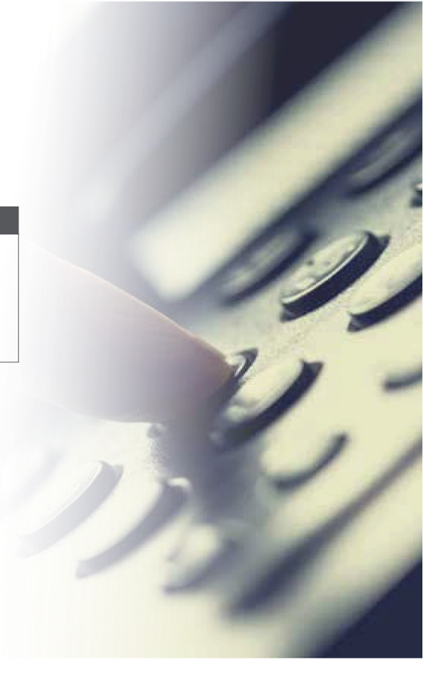
Cardholder Data Security (PCI)
For further information on Cardholder Data Security please contact our dedicated security team who will be able to assist you in any queries you may have.
Who to contact? | For
Cardholder Data Security Team (PCI) Mon – Fri (09:00 – 17:00) Email: datasecurity@aibms.com | Support when completing your Data Security (PCI) submission
ROI: 1800 81 66 05
NI: 0330 808 1653
GB: 0330 808 1652

Slide 19

Fraud Prevention
Card Present Transactions
The best way to avoid fraud in a Card Present situation is to ask the Cardholder to complete the Sale using Chip & PIN.
If this is not possible, you can swipe the card and get a signature. Then it is important to check the following:
Check the signature on the receipt against the signature on the card –
Do the signatures match?
Does the signature panel look as if someone has tampered with it?
Check the card number –
Does the number embossed on the card match the number on the terminal print-out?

Slide 20

Fraud Prevention
Check the customer –
Are they acting suspiciously in any way or distracting you from following procedures?
NOTE:
Never manually key a Card Present transaction. If the cardholder states that they are having issues with their card or do not have their PIN, treat this as suspicious.
Always stay in the vicinity of the terminal; never leave the terminal with the cardholder or let them distract you, therefore enabling them to tamper with the terminal.

Slide 21

Fraud Prevention
Cardholder Not Present Transactions
Card Not Present transactions are taken entirely at your own risk. Unfortunately, we cannot offer any guarantee of payment, actual or implied, even if you have an Authorisation code.
Gaining an Authorisation code simply means that the card has not been reported lost or stolen and has enough money on it at the time of the transaction.
If you wish to process a Card Not Present transaction (e.g. via Mail Order/ Telephone Order or over the Internet), please proceed with caution and take extra care to make sure it is the genuine Cardholder who placed the order.
Mail Order/Telephone Orders (MOTO) Transactions
Always request the card security code – the 3 digits on the signature strip, or the 4 digits on the front of an American Express card.
If a customer wants to collect the goods, then request that they must call in person and bring the card along to complete the Sale using the Chip & PIN technology.

Slide 22

Fraud Prevention
eCommerce Transactions
When processing payments online we strongly recommend 3D Secure – now branded Visa Secure and Mastercard Identity Check – to minimise the risk of online fraud. Under Strong Customer Authentication rules, most online payments also have to be authenticated this way.
Please be sure you contact your Payment Service Provider and request that they enable 3D Secure on your website.

Slide 23

Chargebacks
A Chargeback is a transaction which the cardholder has disputed. There are various reasons they might do this:
Fraud committed on their card
They don’t recognise the business name on their statement
No authorisation was gained (this is more commonly disputed by the cardholder’s issuing bank).
From your perspective, this means the reversal of a previously cleared transaction; the cardholder’s account is credited with the value of the sale and your account is debited.
To avoid chargebacks, please follow the fraud prevention guidelines above. Please also make sure that the trading name of your business, that appears on your customers’ card statement is easily recognisable.
We provide detailed information in relation to chargeback prevention and responses in our chargeback handbook which you can access free of charge at www.aibms.com/help/

Slide 24
Merchant Cash Advance
Funding that flexes with your sales, provided by our partner YouLend.
A merchant cash advance gives you a lump sum today against your future card takings. Instead of fixed monthly instalments, you repay an agreed percentage of each day's card sales, so repayments rise and fall with how your business is trading.
How it works
Apply online in minutes – no physical paperwork required.
YouLend reviews your card sales data and returns a decision, typically within 24 hours.
Once approved, funds can reach your account in as little as 24 to 48 hours.
Repayments are collected automatically as a percentage of your daily card sales.
What it costs
There is no interest and no fixed monthly repayment. You agree a single fixed fee upfront, so you know the total repayable from day one. Because the fee is fixed, repaying early does not reduce it.
Who it suits
Businesses that take a meaningful share of their revenue on card, from around three months of trading. Advance amounts and terms are agreed case by case with YouLend based on your card sales.
Where to find out more: full details, eligibility and the application form are on aibms.com. Your welcome email includes a direct link.
Note: Provided by YouLend, not AIB Merchant Services, and subject to YouLend's eligibility criteria and terms.
https://www.aibms.com/payment-solutions/grow-your-business/business-funding/

Slide 25
Fraud Prevention Checklist
A quick check before you accept a payment – print it and keep it by the till.
When the card is present
Is the customer rushing you or trying to distract you?
Does the signature or PIN entry match the card presented?
Is the card damaged, altered or does the name look tampered with?
Are they buying high value goods with no interest in price, size or colour?
Have you kept the card in sight for the whole transaction?
When the card is not present
Do the billing and delivery addresses match?
Have you checked the security code on the back of the card?
Is the order unusually large, or repeated from the same card?
Is the delivery address a hotel, freight forwarder or vacant property?
Have you used the address and security code checks?
If something feels wrong
Do not confront the customer. Complete the transaction if it is safe to do so, then call Customer Services straight away. Never accept a transaction you believe is fraudulent.

Slide 26
Handling a Chargeback
If a cardholder disputes a transaction we will write to you with the details, the reason code and the date by which you must respond. Deadlines are set by the card schemes and cannot be extended, so please respond as soon as you can.
Full step-by-step guidance – what the reason codes mean, the evidence to gather and how to submit your defence – is in our chargeback handbook, free to download here:
www.aibms.com/help/
Reducing chargebacks in future
Use a clear trading name on statements, answer customer queries quickly, keep proof of delivery, and refund promptly when a refund is due.
Questions? Email chargebacks@aibms.com or call Customer Services.

Slide 27
Your First Week
Five things to do to get set up properly.
1. Check your terminal
Plug it in, run a test transaction and confirm it connects. The helpline number is on the sticker on the machine.
2. Note your Merchant ID
Keep it somewhere you can find it – it is on your welcome letter and at the top right of page 1 of your statement. You will be asked for it every time you call us.
3. Register for Insight
It is where you see your transactions, statements and settlement information.
4. Complete your data security check
Validate your compliance in the AIB Merchant Services portal within 30 days and renew it every year.
5. Save the helpline numbers
Put Customer Services and your terminal helpline into your phone now, so they are there when you need them.
If anything is unclear, call Customer Services or speak to your account manager. We are here seven days a week.

